Slide 1

MEA(R)N Full Stack Programming
MongoDB

Slide 2
Objectives
In this session, you will learn to....
Introduction to NoSQL
Advantages and Disadvantages of NoSQL Database
Introduction to MongoDB
Architecture of MongoDB
Components of MongoDB
Features of MongoDB
Why Use MongoDB ?
Difference between NoSQL vs RDBMS
MongoDB

Slide 3
NoSQL Database
NoSQL databases are non-tabular databases and store data differently than relational tables.
NoSQL databases come in a variety of types based on their data model.
There are four types NoSQL databases:
Document database - Store data in document similar to JSON. It store variety of types strings, numbers, Booleans, array, and objects.
key-value database - Each item contains keys and values.
wide-column database - store data in tables, rows, and dynamic columns
graph database - store data in nodes and edge, where node contains data and edge store the relationships between nodes.
All provide flexible schemas and scale easily with large amounts of data and high user loads.
MongoDB

Slide 4
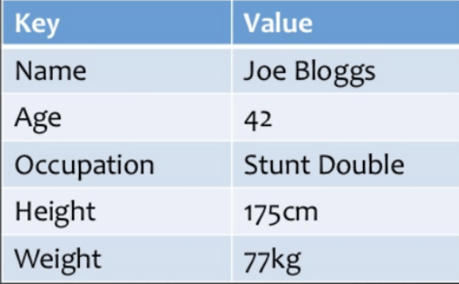
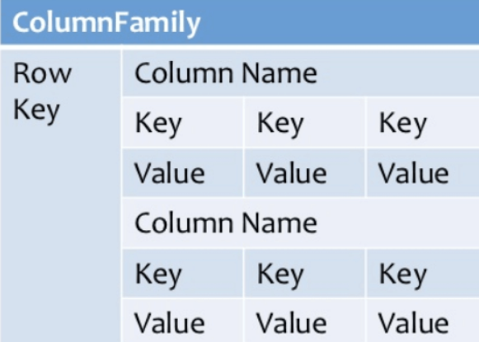
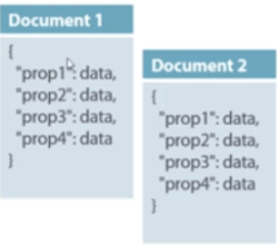
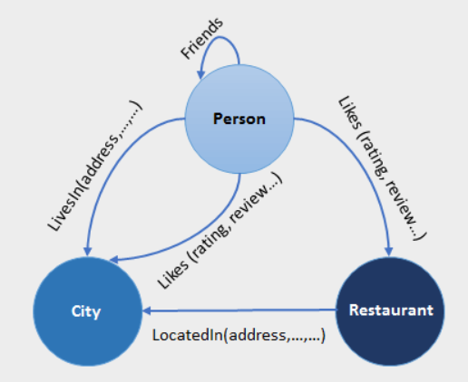
Key-value pair
Column based
Document Based
Graph based
MongoDB

Slide 5
Advantages of NoSQL Database
NoSQL databases simplify application development, particularly for interactive real-time web applications, such as those using a REST API and web services.
It provide flexibility for data that has not been normalized, which requires a flexible data model, or has different properties for different data entities.
It offer scalability for larger data sets, which are common in analytics and artificial intelligence (AI) applications.
NoSQL databases are better suited for cloud, mobile, social media and big data requirements.
It is designed for specific use cases and are easier to use than general-purpose relational or SQL databases for those types of applications.
MongoDB

Slide 6
Disadvantages of NoSQL Database
No standardization rules
Limited query capabilities
It does not offer any traditional database capabilities, like consistency when multiple transactions are performed simultaneously.
When the volume of data increases it is difficult to maintain unique values as keys become difficult
Doesn’t work as well with relational data
Open source options so not so popular for enterprises.
MongoDB

Slide 7
What is MongoDB ?
MongoDB is a scalable, open source, high performance, document-oriented NoSQL database.
It contains the data model, which allows you to represent hierarchical relationships.
It uses JSON-like documents with optional schema instead of using tables and rows in traditional relational databases.
Documents containing key-value pairs are the basic units of data in MongoDB.
Launched by 10gen later known as a MongoDB inc.
MongoDB

Slide 8
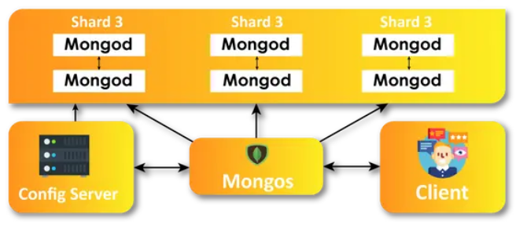
Architecture of MongoDB
MongoDB

Slide 9
Components of MongoDB Architecture
Database
It is also called the physical container for data.
Every database has its own set of files existing on the file system.
In a single MongoDB server, there are multiple databases present.
Collection
It consists of various documents from different fields.
All the collections reside within one database.
no schemas are present.
Documents
It contains any number of key value pairs / varying fields.
Data records are stored as BSON format ( binary representation of JSON).
MongoDB

Slide 10
Features of MongoDB
Schema-less Database
One collection can hold different types of documents in terms of fields, contents, and size.
It is not necessary that the one document is similar to another document like in the relational databases.
Document oriented
Data is stored in fields ( key-value pairs ) instead of rows and column.
Each document contains unique object ID.
Indexing
Every field in the documents is indexed with primary and secondary indices this makes easier and takes less to get or search data from the pool of data.
MongoDB

Slide 11
Features of MongoDB
Scalability
It provides horizontal scalability with the help of sharding.
large amount of data is partitioned into data chunks using the shard key, and these data chunks are evenly distributed across shards that reside across many physical servers.
Replication
high availability and redundancy with the help of replication.
it creates multiple copies of the data and sends these copies to a different server so that if one server fails, then the data is retrieved from another server.
Aggregation
It allows to perform operations on the grouped data and get a single result or computed result.
MongoDB

Slide 12
Why use MongoDB ?
It is build on a scale-out-architecture that has become popular with developers of all kinds for developing scalable applications with evolving data schemas.
It easy for developers to store structured and unstructured data.
It used JSON format which is directly maps to native objects in most modern programming languages.
No need to think about normalizing data.
It can scale both vertically or horizontally to accommodate large data loads.
It is widely used in various industries such as telecommunications, gaming, finances, healthcare, and retail etc.
MongoDB

Slide 13
How MongoDB is different from RDBMS ?
NoSQL | RDBMS
It is a non-relational and document-oriented database. | It is a relational database.
It is suitable for hierarchical data storage. | It is not suitable for hierarchical data storage.
It has a dynamic schema. | It has a predefined schema.
It centers around the CAP theorem (Consistency, Availability, and Partition tolerance). | It centers around ACID properties (Atomicity, Consistency, Isolation, and Durability).
Much faster than RDBMS. | It slower than NoSQL database.
MongoDB

Slide 14
Install and Configuration of MongoDB
MongoDB

Slide 15
Objectives
In this session, you will learn to....
Introduce to Data Modeling and Schema Design
Working with databases
Working with collections
Working with primitive datatypes
Working with query
CRUD operations with collection
Working with operators
Working with collection methods
MongoDB

Slide 16
Data Modeling and Schema Design
What is Data Modeling ?
Data modeling is the blueprint on which a full-fledged database system is developed.
The main function of a data model is to facilitate visual information of how the relationship between two or a group of data points.
Data models for a database system can be conceptualized into three categories:
Conceptual data models
It contains the entity class, characteristics, constraints, and the relationship between security and data integrity requirements.
MongoDB

Slide 17
Data Modeling and Schema Design
Logical data models
It provide subjective information on the relationships between data sets.
Physical data models
Physical data model provides a schema/layout for the data storing rituals within a database.
It offers a finalized proposition that can be implemented in a relational database.
MongoDB

Slide 18
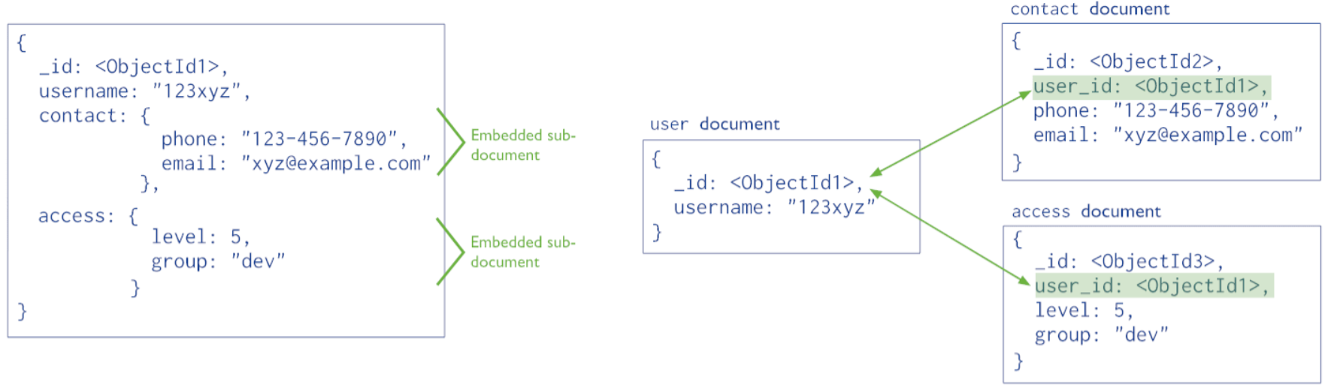
Types of Data Model
Embedded data model
Normalized data model
Embedded Model
Normalized Model
MongoDB

Slide 19
Relationship in MongoDB Data Modeling
One-to-One Relationship
{ “_id”: ObjectId(“user1”), “name”: umesh }
One-to-many Relationship
{ “_id”: ObjectId(“user1”), “name”: umesh
addresses: [ {“streat”: “station road”, “city”:”Vadodra”},
addresses: [ {“streat”: “station road”, “city”:”surat”}
}
Many to Many Relationship
User
{ “_id”: ObjectId(“user1”}, tasks: [ObjectId(“T1”), ObjectId(“T2”), ObjectId(“T1”)}
Tasks
{“_id”: ObjectId(“task1”}, “owners”:[ObjectId(“owner1”), ObjectId(“owner2”)]}
MongoDB

Slide 20
Creating Database
MongoDB has not create command for creating a database.
You can make use of the use command followed by database_name for creating a new database.
Otherwise, it will return the existing database that has the name.
Syntax : use <database name>
Example:
use myDatabase
MongoDB

Slide 21
Database Operation Commands
To list / show existing databases use the following commands.
show databases
or
show dbs
To display current database use the following command
db
To remove / drop the existing database use the following command.
db.dropDatabase()
MongoDB

Slide 22
Collection Commands
Collections are just like tables in relational databases, they also store data, but in the form of documents.
A single database is allowed to store multiple collections.
To list the collections from the database, use the following commands.
show collections Or show tables
To create a new collection
Syntax : db.createCollection(<collection name>)
db.createCollection(“employees”)
MongoDB

Slide 23
Collection Commands
To rename an existing collection, use the following commands.
Syntax : db.<collection_name>.renameCollection(<new_name>)
db.employee.renameCollection(“employees”)
To drop a existing collection from the database, use the following commands.
Syntax : db.<collection_name>.drop()
db.employee.drop()
MongoDB

Slide 24
General Datatypes in MongoDB
String – It is used to store string type of data ( UTF – 8).
db.student.insert( { “firstname”:”Mahesh”, “lastname”:”Shah”})
Integer – It is used to store an integer value ( 32 – bit / 64 – bit signed )
db.student.insert( { “firstname”:”Mahesh”, “lastname”:”Shah”, age: 20})
Boolean – It is used to store true or false.
db.orders.insert( { “orderID”:”O001212033”, “status”:true})
Double – It is used to store floating-point values.
db.orders.insert( {{ “orderID”:”O001212033”, “total”:31000.89})
Decimal – It is used to store floating-value values ( 128 bit ).
db.orders.insert( {“orderID”:”O001212033”, “total”:31000.89})
MongoDB

Slide 25
General Datatypes in MongoDB
Null – It is used to store the null value.
db.students.insert( { “studentID”:”20030010012122”, “mobile”: null})
Array – It is used to store the same or different datatypes values in it. The array created using Square brackets ([]).
db.students.insert( { “studentID”:”20030010012122”, “mobileno”: [
“98240456987”,”9824112365”] } )
Date – It is used to store date type of data.
db.students.insert( { “studentID”:”20030010012122”, “dateofreg”: “10-10-2022”, “dateofbirth”: “ISODate(“2021-02-03T19:30:40:014Z”) } )
Timestamp – It is used to store timestamp data ( 64 bit ).
db.students.insert( { “studentID”:”20030010012122”, “timstamp”: Timestamp(1612380924,1)} )
MongoDB

Slide 26
General Datatypes in MongoDB
Object – It is used store embedded documents ( is also called nested documents).
db.book.insert({ Book:{name:”C programming”, author:”Mahesh”}}) {
“acknowledged”: true,
“insertedID”: ObjectId(“601af71f6fd4aa34c9c6df9”)
}
ObjectID – It is used to store hexadecimal data ( length is 12 bytes ).
db.book.find().pretty()
{
“_id” : ObjectId(“601af71f6fd4aa34c9c6df9”)
“Book”: { name:”C programming”, author:”Mahesh” }
}
MongoDB

Slide 27
General Datatypes in MongoDB
RegularExpression – It is used to store Regular Expression.
var expression = new RegExp(“%gfg”)
db.regexpcollection.insert({ regexpression : expression}){
“acknowledged”: true,
“insertedID”: ObjectId(“601af71f6fd4aa34c9c6df9”)
}
Binary Data – It is used to store binary data.
db.project.insert({“name”:”Mahesh”, “duration”: 100,
“binarydata”:”1101110001”}) {
“acknowledged”: true,
“insertedID”: ObjectId(“601af71f6fd4aa34c9c6df9”)
}
MongoDB

Slide 28
Querying Document
To list all the documents from collection.
db.employees.find()
To list all the documents in organized form.
db.employees.find().pretty()
To list only specific fields from collection.
db.employees.find({}, {fullname: 1, Mobile: 1} )
db.employees.find({}, {fullname: true, Mobile: true} )
MongoDB

Slide 29
Querying Document
To list all the documents based on criteria from collection.
db.employees.find({}, {“Mobile”:”9998321992”})
db.employees.find({“Mobile”:”9998321992”})
db.students.find({"city":"Anand","course":"Full Stack using Python"}).pretty();
let result = db.employees.find().toArray()
print ( result )
result.foreach((e) => print(“Full name :”, e.fullname)
MongoDB

Slide 30
Querying Document ( using $and, $or, $not, $nor )
$and
Syntax :
{ $and: [ { Expression1 }, { Expression2 }, ..., { ExpressionN } ] }
or
{ { Expression1 }, { Expression2 }, ..., { ExpressionN }}
db.students.find( {$and: [{"city":"Anand"}, {"course":"Full Stack using Python"}]}).pretty()
db.students.find({"city":"Anand","course":"Full Stack using Python"}).pretty()
db.students.find({"city":"Anand","course":"Full Stack using Python"},
{"first_name":1, "_id":false}).pretty()
MongoDB

Slide 31
Querying Document ( using $and, $or, $not, $nor )
$or
Syntax :
{ $or: [ { Expression1 }, { Expression2 }, ..., { ExpressionN } ] }
db.students.find( {$or: [{"city":"Anand"}, {"city": “Bharuch"}]}).pretty()
db.students.find({$or: [{"city":"Anand"}, {"city ": "Bharuch"}]},
{"first_name":1, “last_name”:1}).pretty()
MongoDB

Slide 32
Querying Document ( using $and, $or, $not, $nor )
$not
Syntax :
{ field: { $not: { operator-expression } } }
db.students.find({"city": {$not: {$eq : "Anand"}}}, {"first_name":1,"city":1}).pretty()
db.students.find({"city": {$not: {$in :
["Anand","Vadodara","Surat"]}}},
{"first_name":1,"city":1}).pretty()
MongoDB

Slide 33
Querying Document ( using $and, $or, $not, $nor )
$nor
Syntax :
{ $nor: [ { Expression1 }, { Expression2 }, ... { ExpressionN } ] }
db.students.find({$nor:
[
{"city": "Anand"},{"first_name":"Ganesh"}
]}, {"first_name":1,"city":1}).pretty()
db.students.find({$nor: [
{"city": {$in: ["Anand", "Vadodara"]}}
]}, {"first_name":1,"city":1}).pretty()
MongoDB

Slide 34
Querying Document ( Using Comparison Operators)
$gt
Syntax :
{field: {$gt: value}}
db.emps.find({"salary": {$gt: 15000}}).pretty();
db.emps.find({$and: [{"salary": {$gt: 15000}}, {"gender": "male"}]}).pretty();
db.emps.find({$and: [{"salary": {$gt: 15000}}, {"gender": "male"}, {"age": {$gt: 38}}]}).pretty();
MongoDB

Slide 35
Querying Document ( Using Comparison Operators)
$lt
Syntax :
{field: {$lt: value}}
db.emps.find({"salary": {$lt: 15000}}).pretty();
db.emps.find({$and: [{"salary": {$gt: 15000}}, {"gender": "male"}]}).pretty();
db.emps.find({$and: [{"salary": {$gt: 15000}}, {"gender": "male"}, {"age": {$gt: 38}}]}).pretty();
MongoDB

Slide 36
Querying Document ( Using Comparison Operators)
$eq
Syntax :
{field: {$eq: value}}
db.emps.find({"salary": {$eq: 15000}}).pretty();
db.emps.find({$and: [{"salary": {$eq: 15000}}, {"gender": “female"}]}).pretty();
db.emps.find({$and: [{"salary": {$eq: 15000}}, {"gender": "male"}, {“job_title": {$eq: “DevOps Engineer”}}]}).pretty();
MongoDB

Slide 37
Querying Document ( Using Comparison Operators)
$gte
Syntax :
{field: {$gte: value}}
db.emps.find({"salary": {$gte: 15000}}).pretty();
db.emps.find({$and: [{"salary": {$gte: 15000}}, {"gender": "male"}]}).pretty();
db.emps.find({$and: [{"salary": {$gte: 15000}}, {"gender": "male"}, {"age": {$gte: 38}}]}).pretty();
MongoDB

Slide 38
Querying Document ( Using Comparison Operators)
$lt
Syntax :
{field: {$lte: value}}
db.emps.find({"salary": {$lte: 15000}}).pretty();
db.emps.find({$and: [{"salary": {$gte: 15000}}, {"gender": "male"}]}).pretty();
db.emps.find({$and: [{"salary": {$gte: 15000}}, {"gender": "male"}, {"age": {$gte: 38}}]}).pretty();
MongoDB

Slide 39
Querying Document ( Using Comparison Operators)
$ne
Syntax :
{field: {$ne: value}}
db.emps.find({"salary": {$ne: 15000}}).pretty();
db.emps.find({$and: [{"salary": {$ne: 15000}}, {"gender": “female"}]}).pretty();
db.emps.find({$and: [{"salary": {$ne: 15000}}, {"gender": "male"}, {"age": {$ne: 38}}]}).pretty();
MongoDB

Slide 40
Querying Document ( Using Comparison Operators)
$in
Syntax :
{field: {$in: [value1, value2, value3, ...]}}
db.emps.find({"job_title": {$in: ["Tester","Designer"]}}).pretty()
db.emps.find({$and: [{"job_title": {$in: ["Tester","Designer"]}}, {"salary": {$gt: 15000}}]}).pretty()
db.emps.find({$and: [{"job_title": {$in: ["Tester","Designer"]}}, {"age": {$in: [41,32]}}]}).pretty()
MongoDB

Slide 41
Querying Document ( Using Comparison Operators)
$nin
Syntax :
{field: {$in: [value1, value2, value3, ...]}}
db.emps.find({"job_title": {$nin: ["Tester","Designer"]}}).pretty()
db.emps.find({$and: [{"job_title": {$nin: ["Tester","Designer"]}}, {"salary": {$gt: 15000}}]}).pretty()
db.emps.find({$and: [{"job_title": {$nin: ["Tester","Designer"]}}, {"age": {$in: [41,32]}}]}).pretty()
MongoDB

Slide 42
Arithmetic Operators
$add
$add operator can be used to add multiple numbers together and can accept any number of arguments.
It is commonly used in the $project, $group, and $addFields stages of an aggregation pipeline to add multiple expressions together and generate new fields or values.
Syntax : { $add: [ <expression1>, <expression2>, ... ] }
Example:
db.workinghrs.aggregate([ {$project: {
_id: "$empno", month: "$month",
totalValue: { $add: [{ $multiply: ["$totalhrs", "$wages"] } ] }
} } ] )
MongoDB

Slide 43
Arithmetic Operators
$subtract
$subtract calculates the difference between two numeric values and returns the result.
It is commonly used in the $project, $group, and $addFields.
Syntax : { $subtract : [ <expression1>, <expression2>, ... ] }
Example
db.workinghrs.aggregate([
{$project: {
_id: "$empno", month: "$month",
total: { $add: [{ $multiply: ["$totalhrs", "$wages"]}]},
taxvalue: { $subtract: ["$total",5]} } } ] )
MongoDB

Slide 44
Arithmetic Operators
$divide
$divide operator can be used to perform division operations.
It is commonly used in the $project, $group, and $addFields.
Syntax : { $divide : [ <expression1>, <expression2>, ... ] }
Example:
db.testemp.aggregate([ {
$project: {
name: 1,
hourly_salary: { $divide: ["$salary", "$hours_worked"] } } }
])
MongoDB

Slide 45
Arithmetic Operators
$multiply
$multiply used to calculate the product of two numbers in an expression and return the result.
It can be used in the aggregation pipeline.
Syntax : { $multiply : [ <expression1>, <expression2>, ... ] }
Example:
db.workinghrs.aggregate([
{$project:
{ totalValue: { $multiply: ["$totalhrs", "$wages"] }
} }
] )
MongoDB

Slide 46
Insert Document
The insert() method inserts a document or documents into the collection.
You can insert documents with or without _id ( MongoDB automatically as _id for each document).
db.Collection_name.insert(<document or [ document1, document2…]>)
Example
1. db.employees.insert(
{“id”: “E001”, “fullname”: “Sanjay Shah”, “Mobile”: “9998321992”})
MongoDB

Slide 47
Insert Document
2. document = ( {“id”: “E002”, “fullname”: “Mahesh Patel”, “Mobile”:
“9824024212”} )
db.employees.insert(document)
3. db.employees.insertOne( {“id”: “E003”, “fullname”: “Aishwarya Rai”, “Mobile”: “9824452525”})
4. db.employees.insertMany(
[
{“id”: “E004”, “fullname”: “Amit Rai”, “Mobile”: “9824452521”},
{“id”: “E005”, “fullname”: “Akshay Kumar”, “Mobile”: “9824265655”}
])
MongoDB

Slide 48
Insert Document ( Bulk Insert Operations )
var bulk = db.stud.initializeOrderedBulkOp()
bulk.insert( { first_name: “Jalpa", last_name: “Shah" } )
bulk.insert( { first_name: “Mahesh", last_name: “Bhatt" } )
bulk.insert( { first_name: “Naresh", last_name: “Vagashsia" } )
bulk.insert( { first_name: “Prakash", last_name: “Patel" } )
bulk.insert( { first_name: “Pinal", last_name: “Srivasta" } )
bulk.execute();
MongoDB

Slide 49
Update Document
The update() method updates the values in the existing document in the collections of MongoDB.
db.COLLECTION_NAME.update({selection_criteria}, {$set:{updated_data}}, {
upsert: <boolean>, multi: <boolean>, writeConcern: <document>,
collation: <document>, arrayFilters: [ <filterdocument1>, ... ],
hint: <document|string> })
The first_parameter is the older value in the form of documents.
The second parameter must contain a $set keyword to update the following specify document values.
The third parameter is optional.
MongoDB

Slide 50
Update Document
Example
db.students.update({"rollno":"200300999011"},{$set: {"first_name":"Mahesh","last_name":"Shah"}})
db.students.updateOne({"city":"Surat"},{$set: {"city":"Nasari"}})
Phoneno fields does not exists so it add as new fields into collection
db.students.update({"rollno":"200300999011"},{$set: {“phoneno“:”400300125”}})
db.students.updateMany({"city":"Anand"},{$set: {"country":"india"}})
MongoDB

Slide 51
Delete Document
The remove() method removes documents from the database.
It can remove one or all documents from the collection that matches the given query expression.
If you pass an empty document({}) in this method, then it will remove all documents from the specified collection.
Syntax :
db.Collection_name.remove(<matching_criteria>)
MongoDB

Slide 52
Delete Document
Example
//Remove all documements
db.students.remove( {} )
db.students.deleteOne( {} )
db.students.remove ({ "first_name": "Ganesh" }, true)
db.students.deleteOne({ "first_name": "Ganesh" })
db.students.deleteMany({})
db.students.deleteMany( { city: { $in: [ “Anand” ] } } )
MongoDB

Slide 53
Distinct() Method
The distinct() method finds the distinct values for a given field across a single collection and returns the results in an array.
Syntax :
db.Collection_name.distinct(field : <string>)
Example:
db.students.distinct( “city”)
MongoDB

Slide 54
Sort() Method
The sort() method specifies the order in which the query returns the matching documents from the given collection.
You must apply this method to the cursor before retrieving any documents from the database.
It takes a document as a parameter that contains a field: value pair that defines the sort order of the result set.
The value is 1 or -1 specifying an ascending or descending sort respectively.
Syntax:
db.Collection_Name.sort({field_name:1 or -1})
MongoDB

Slide 55
Sort() Method
Example
db.students.find().sort({“job_title”:1})
db.students.find({}, {"first_name":1, "last_name":1, "city":1}).sort({"job_title":1})
db.students.find().sort({“course":1, "city": 1}).pretty()
db.students.find().sort({" course ":1, "city": -1}).pretty()
db.students.find({"city":"Anand"}).sort({"couurse":1}).pretty()
MongoDB

Slide 56
limit() Method
The limit() method limits the number of records or documents.
It basically defines the max limit of records/documents that you want display in result.
Syntax:
db.collectionName.find(<query>).limit(<number>)
Example
db.students.find().limit(5).pretty()
db.students.find({“city”:”Aannd”}).limit(5).pretty()
db.students.find({“city”:”Aannd”}).limit(-2).pretty()
MongoDB

Slide 57
skip() Method
The skip() method will skip the first n document from the query result.
Require to pass the number of records/documents to be skipped.
Syntax:
db.collectionName.find(<query>).skip(<offset>)
Example
db.students.find().skip(5).pretty()
db.students.find({“city”:”Aannd”}).skip(2).pretty()
db.students.find({“city”:”Aannd”}).skip(2).limit(2)pretty()
MongoDB

Slide 58
More methods
The findOne() method finds and returns one document that matches the given selection criteria.
If multiple documents satisfy the given query expression, then this method will return the first document according to the natural order which reflects the order of documents on the disk.
If documents does not exists then it will return null as a result.
Syntax:
db.Collection_Name.findOne(query:<document>)
Example:
db.students.findOne()
db.students.findOne({"city":"Anand"})
db.students.findOne({"city":"Anand"}, {“first_name”:1,”last_name”:1})
MongoDB

Slide 59
More methods
The replaceOne() methos is used to replace the existing document with the replace document.
Syntax
db.collection.replaceOne(<filter>, <replacementDocument>)
Example
db.stud.replaceOne({},
{"first_name": "Anna", "last_name":"khan", "city":"Delhi"})
db.students.replaceOne( { rollno: "200300999010" },
{first_name: "Ramesh", last_name: "Yadav", city: "Vadodara",
course: "Advance Java" } )
MongoDB

Slide 60
More methods
The findOneAndUpdate() method updates the first matched document in the collection that matches the selection criteria.
If more than one document matched the selection criteria then it updates only the first matched document.
_id field remains unchanged.
Syntax
db.collection. findOneAndUpdate(<selection_criteria:<document>,
update_data: <document>)
Example
db.stud.findOneAndUpdate({"city":"surat"},{$set: {"last_name": "shah"}})
MongoDB

Slide 61
More methods
The findOneAndReplace() method replaces the first matched document based on the given selection criteria.
It return the original document if criteria is match else null.
Syntax
db.collection. findOneAndReplace(<selection_criteria:<document>,
replacement: <document>)
Example
db.stud.findOneAndReplace({"first_name":"Anna"},{"first_name":"Ananya",
"last_name":"Khan","city":"Surat"})
MongoDB

Slide 62
More methods
The findOneAndDelete() method deletes a single document based on the selection criteria from the collection.
It deletes the first document from the collection that matches the given filter query expression.
Syntax
db.collection. findOneAndDelete(<filter>)
Example
db.stud.findOneAndDelete({"last_name":"khan"})
MongoDB

Slide 63
Objectives
In this session, you will learn to....
Working with indexes
MongoDB

Slide 64
Create Index
Indexes are special data structure which can be used to find data quickly from documents.
It ordered by the value of the field specified in the index.
createIndex() method is used to create one or more indexes on collections.
Syntax
db.collection_name.createIndex( keys: { field_name: 1/ -1 ….} )
db.collection_name.createIndexes( [keys: { field_name: 1/ -1 …} ] )
db.collection_name.dropIndex(<index_name>…)
db.collection_name.dropIndexes()
db.collection_name.getIndexes()
MongoDB

Slide 65
Create Index ( Examples )
Create an index on first_name fields on collection.
db.stud.createIndex({"first_name":1})
To display an existing indexes from collection.
db.stud.getIndexes()
To remove the named index from collection
db.stud.dropIndex("first_name_1")
To remove all the indexes from collection
db.stud.dropIndexes()
Create an index on multiple fields
db.students.createIndex({"first_name":1,"city":1})
MongoDB

Slide 66
Create Index ( Examples )
Create an index on multiple fields ( -1 denotes in ascending order).
db.students.createIndex({"first_name":1,"city": -1})
Create an multiple indexes.
db.students.createIndexes( [ {“first_name”:1}, {“course”:1}, {“country”:1} ])
Create an unique index on rollno field.
db.marks.createIndex({"rollno":1}, {unique: true})
Create an index on multiples fields ( name property is used to specify name of the index)
db.marks.createIndex({"rollno":1, "fname":1}, {"name": "rollno#name"})
To remove multiple indexes from collection.
db.marks.dropIndexes("rollno_1","roll#name") //droping multiple indexes
MongoDB

Slide 67
Working with Aggregation
Aggregation operations are used to process the data (documents) and return the processed records (documents).
It group the multiple Documents and perform various operations on that group of Documents to return a single value.
$group is used to stage documents into groups according to a “group key”.
A group key is often a field, or group of fields.
The group key can also be the result of an expression.
Syntax:
$group: {
_id: <expression>, // Group key
<field1>: { <accumulator1> : <expression1> },
...}
MongoDB

Slide 68
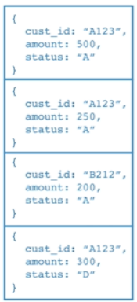
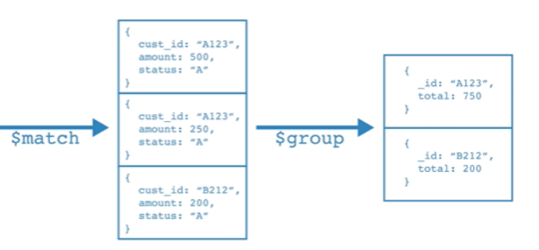
Working with Aggregation
MongoDB

Slide 69
Working with Aggregation ($sum)
db.orders.aggregate( [ { $match: { status: "A" } },
{ $group: { _id: "$customer_id",
total: { $sum: "$item_price" } } }
])
Use multiple group function
db.orders.aggregate( [ { $match: { status: "A" } },
{ $group: { _id: "$customer_id",
total: { $sum: "$item_price" },
average : { $avg: "$item_price"}
} }
])
MongoDB

Slide 70
Working with Aggregation ($sum)
Use function based on multiple group ( Fields )
db.emps.aggregate([
{$group : {_id: {department:"$department", job_title:"$job_title"},
count:{$sum:1}}} ])
Use multiple functions based on multiple group ( Fields )
db.emps.aggregate([{
$group : {_id:{department:"$department", job_title:"$job_title"}, count:{$sum:1},max:{$max: "$salary"}}}])
More group functions are $bottom, $bottomN, $first, $firstN, $last, $lastN, $top, $topN, $max, $maxN and many more….
MongoDB

Slide 71
Reference URLs.
https://www.sqliz.com/mongodb-ref/
https://beginnersbook.com/2017/09/mongodb-tutorial/
https://www.cloudduggu.com/mongodb/
MongoDB

Slide 72
Thank You
MongoDB

